Slide 1

Cisco Academy
CCNA Exploration v5.0
Network fundamentals
Yahdi Siradj
yahdi@politekniktelkom.ac.id
@yahdiinformatik
TK 1073 – Jaringan Komputer
Semester Ganjil 2013 - 2014
Chapter 6:
Network Layer
Hanya dipergunakan untuk kepentingan pengajaran di lingkungan Telkom Applied Science School

Slide 2

Chapter 6: Objektif
Mahasiswa akan mampu:
Menjelaskan bagaimana protokol layer network dan layanan mendukung komunikasi melalui jaringan – jaringan data.
Menjelaskan bagaimana routers menghubungkan koneksi end-to-end dalam industri jaringan skala kecil ke menengah.
Menentukan devais yang tepat untuk merutekan trafik dalam industri jaringan ukuran kecil ke menengah.
Konfigurasi router di level dasar.
Notes:
2

Slide 3
Chapter 6
  6.1 Protokol Layer Network
  6.2 Routing
  6.3 Router
  6.4 Mengkonfigurasi Router Cisco
  6.5 Simpulan
Notes:
Chapter 6 Sections

Slide 4
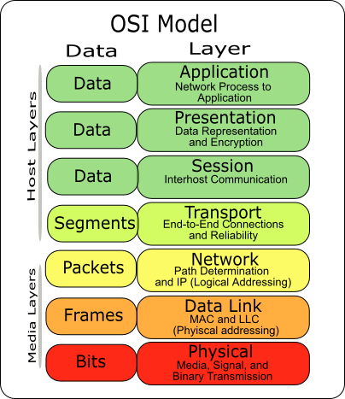
Layer Network
Layer Network
Notes:
Section 6.0

Slide 5
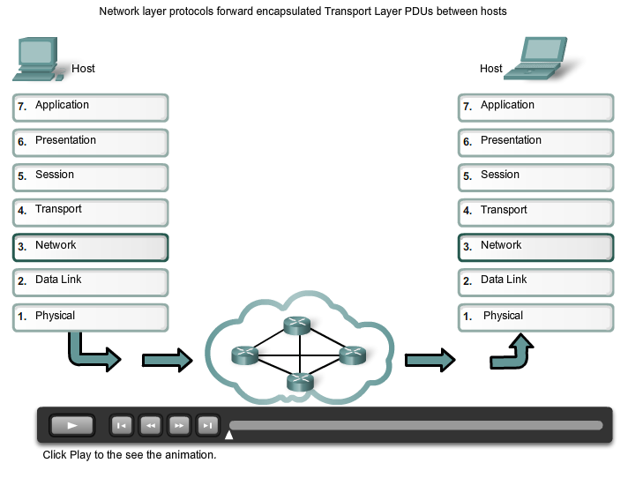
Protokol Layer Network
Layer Network dalam Komunikasi
Notes:
Section 6.1.1

Slide 6
Layer Network dalam Komunikasi
Layer Network
End to End Transport processes
Addressing end devices
Encapsulation
Routing
De-encapsulating
Notes:
Section 6.1.1.1

Slide 7
Layer Network dalam Komunikasi
Protokol Layer Network
Protokol Layer Network yang Umum Dipakai:
Internet Protocol version 4 (IPv4)
Internet Protocol version 6 (IPv6)
Protokol Legacy Novell Network Layer Internetwork Packet Exchange (IPX)
AppleTalk
Connectionless Network Service (CLNS/DECNet)
Notes:
Section 6.1.1.2

Slide 8
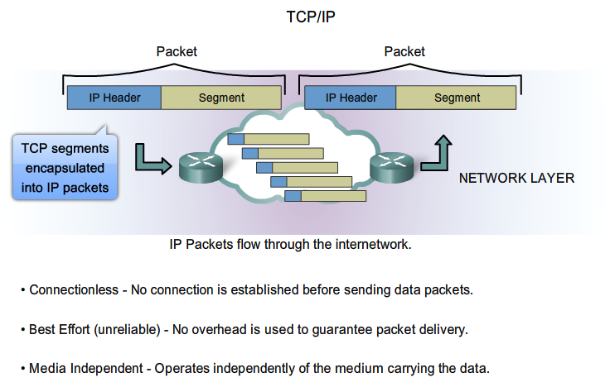
Karakteristik Protokol IP
Karakteristik IP
Notes:
Section 6.1.2.1

Slide 9
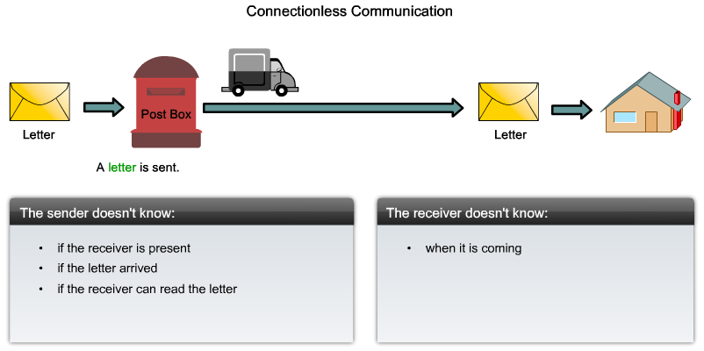
Karakteristik Protokol IP
IP - Connectionless
Notes:
Section 6.1.2.2

Slide 10
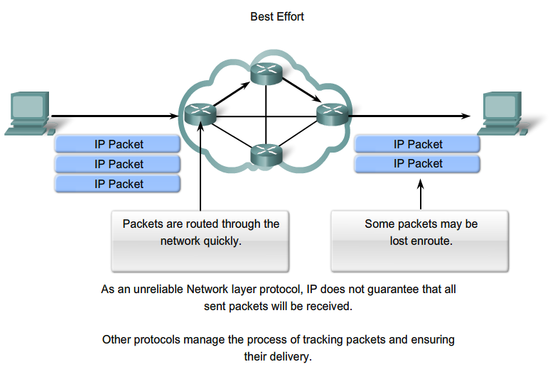
Karakteristik Protokol IP
IP – Best Effort Delivery
Notes:
Section 6.1.2.3

Slide 11
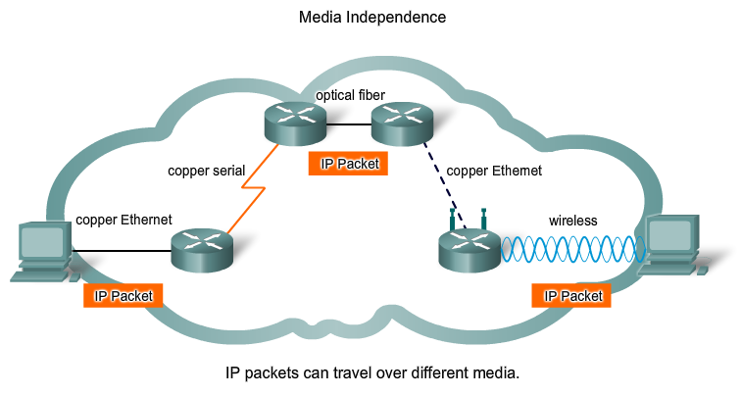
Karakteristik Protokol IP
IP – Media Independent
Notes:
Section 6.1.2.4

Slide 12
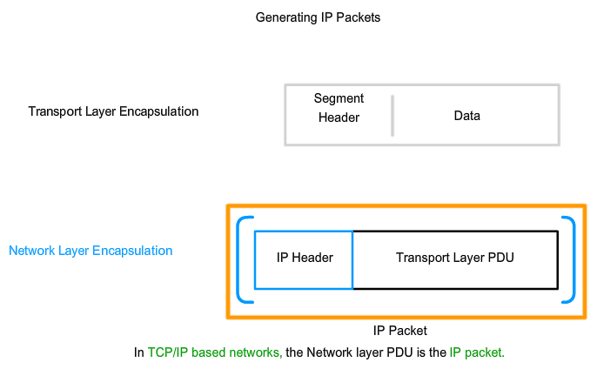
Paket IPv4
Encapsulating IP
Notes:
Section 6.1.2.5

Slide 13
Paket IPv4
IPv4 Packet Header
Version, Differentiated Services (DS), Time-to-Live (TTL),Protocol, Source IP Address, Destination IP Address
Version | IP Header Length | Differentiated Services |  | Total Length
 |  | DSCP | ECN
Identification |  |  |  | Flag | Fragment Offset
Time To Live |  | Protocol |  | Header Checksum
Source IP Address
Destination IP Address
Options (optional) |  |  |  |  |  |  | Padding
Byte 1
Byte 2
Byte 3
Byte 4
Notes:
Section 6.1.3.2

Slide 14
Paket IPv4
IPv4 Header Fields
Internet Header Length (IHL), Total Length, Header Checksum, Identification, Flags, Fragment Offset
Version | IP Header Length | Differentiated Services |  | Total Length
 |  | DSCP | ECN
Identification |  |  |  | Flag | Fragment Offset
Time To Live |  | Protocol |  | Header Checksum
Source IP Address
Destination IP Address
Options (optional) |  |  |  |  |  |  | Padding
Byte 1
Byte 2
Byte 3
Byte 4
Notes:
Section 6.1.3.3

Slide 15
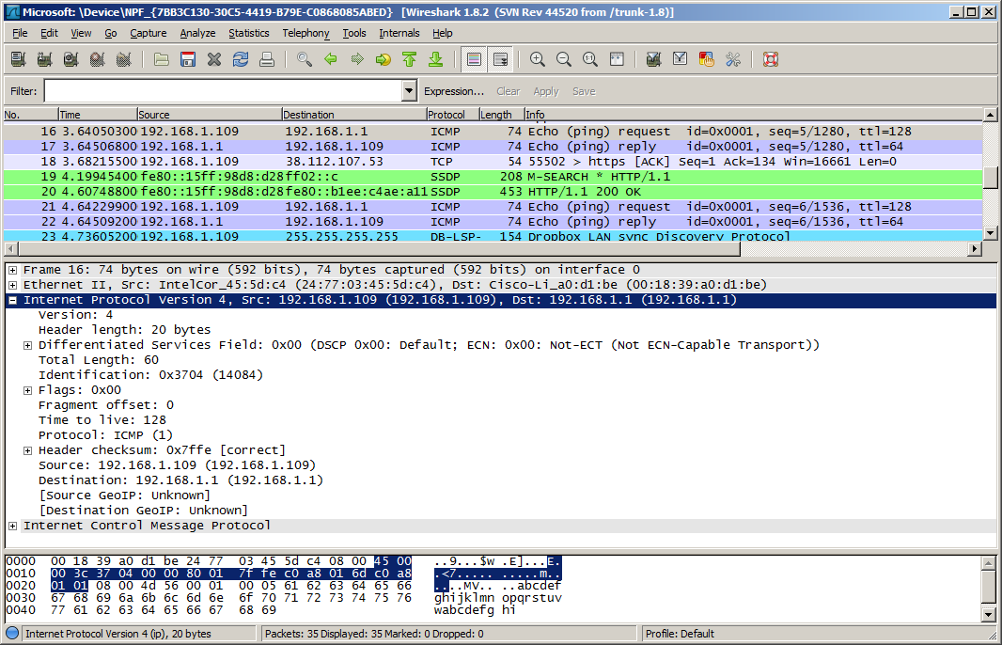
Paket IPv4
Sample IPv4 Headers
PRAKTIKUM
Notes:
Section 6.1.3.4

Slide 16

Layer Network dalam Komunikasi
Kekurangan IPv4
IP Address bisa habis
Perluasan tabel routing Internet
Kurangnya konektivitas end-to-end
Notes:
Section 6.1.4.1

Slide 17
Layer Network dalam Komunikasi
Memperkenalkan IPv6
Ruang alamat yang lebih besar
Packet handling yang lebih baik
NAT Tidak memerlukan NAT
Sudah terintegrasi dengan security
4 miliar alamat IPv4
4,000,000,000
340 undecillion alamat IPv6 addresses
340,000,000,000,000,000,000,000,000,000,000,000,000
Notes:
Section 6.1.4.2

Slide 18
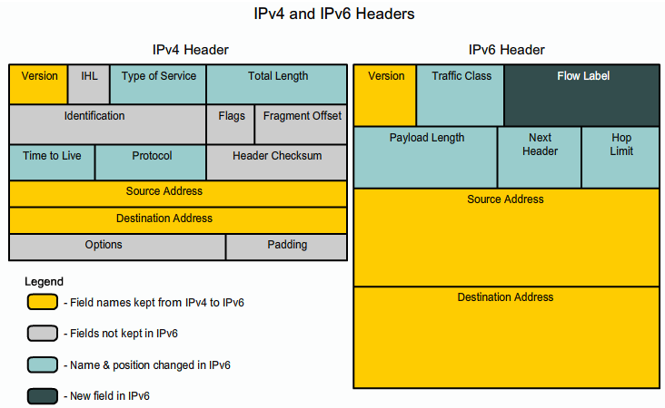
Packet IPv6
Encapsulating IPv6
Notes:
Section 6.1.4.3

Slide 19
Paket IPv6
IPv6 Packet Header
Version | Traffic Class |  | Flow Label
Payload Length |  |  |  | Next Header | Hop Limit
Source IP Address
Destination IP Address
Byte 1
Byte 2
Byte 3
Byte 4
Notes:
Section 6.1.4.4

Slide 20
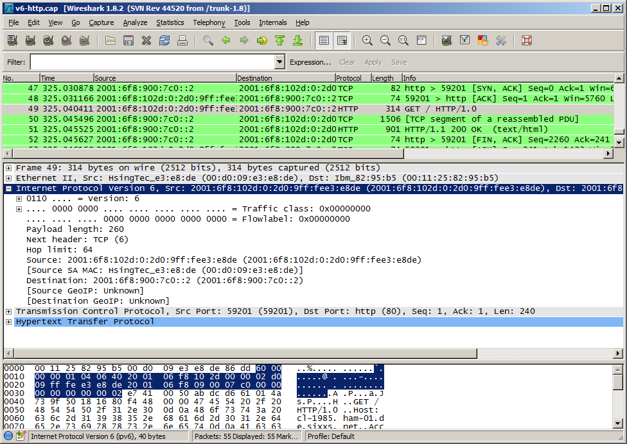
Packet IPv6
Sample IPv6 Header
PRAKTIKUM
Notes:
Section 6.1.4.3

Slide 21
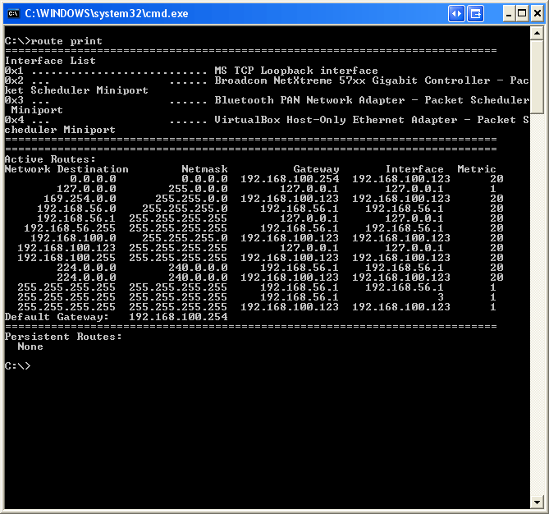
Routing
Host Routing Tables
PRAKTIKUM
Notes:
Section 6.2.1

Slide 22
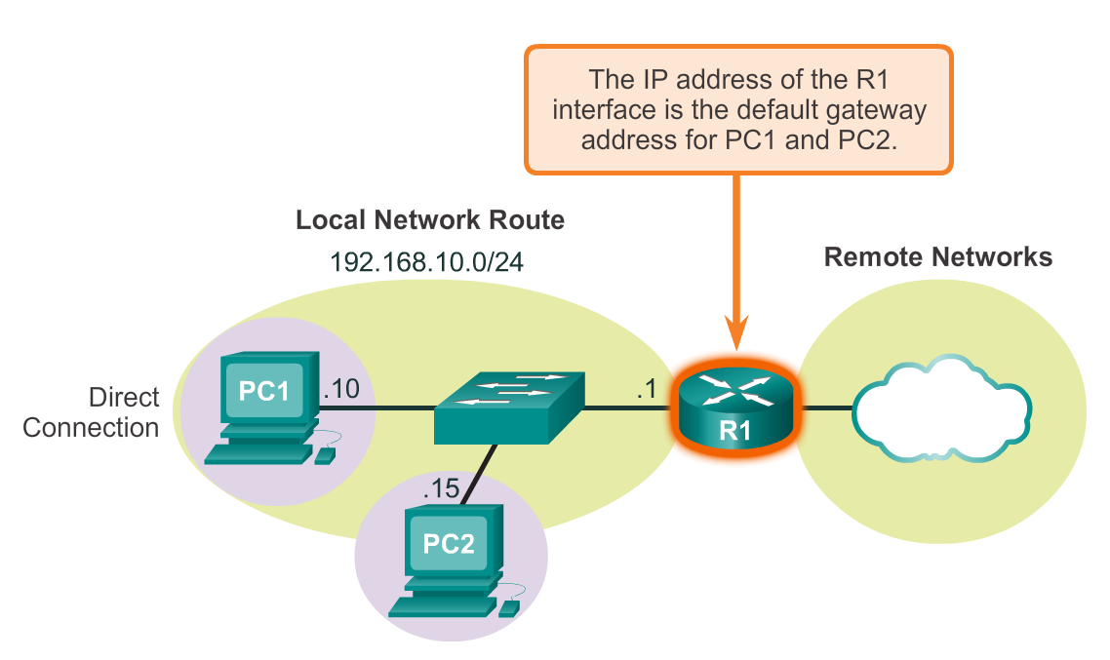
Host Table Routing
Host Packet Forwarding Decision
Notes:
Section 6.2.1.1

Slide 23
Host Tabel Routing
Default Gateway
Host harus menjaga tabel routing lokal mereka untuk memastikan paket layer network ditujukan ke jaringan tujuan yang tepat. Tabel lokal dari host biasanya berisi :
Direct connection
Local network route
Local default route
R
Notes:
Section 6.2.1.2

Slide 24
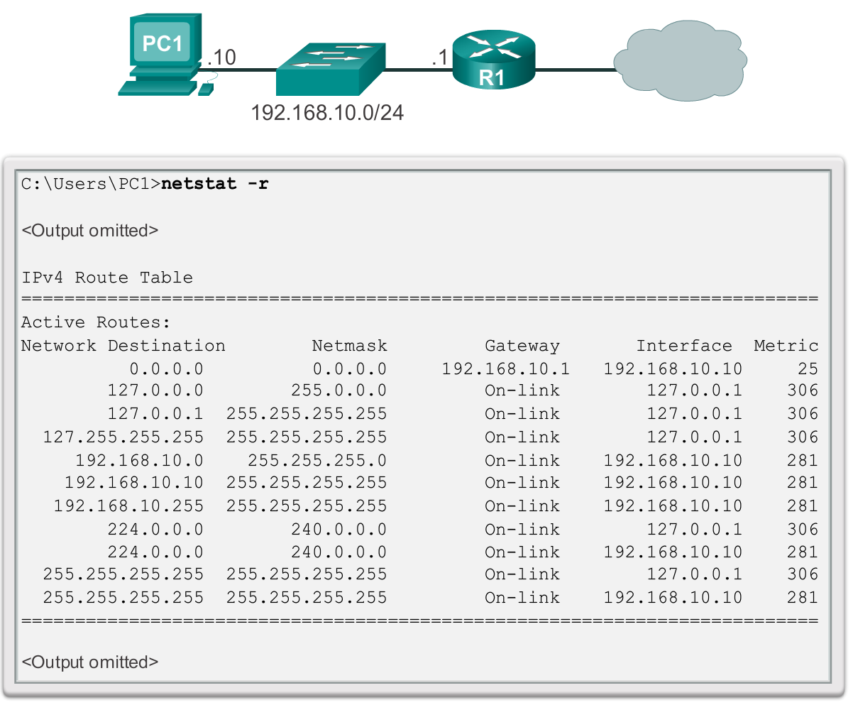
Host Tabel Routing
IPv4 Host Routing Table
PRAKTIKUM
Notes:
Section 6.2.1.3 6.2.1.4

Slide 25
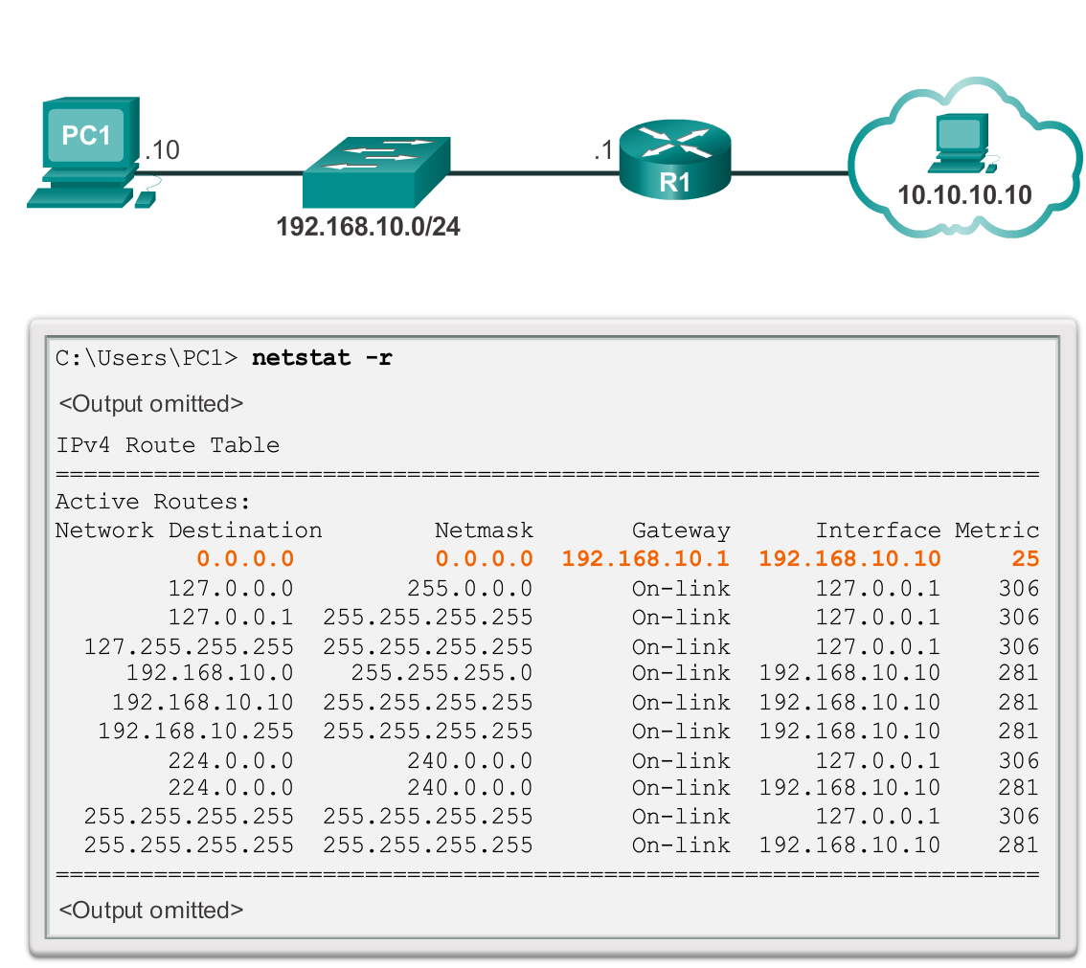
Host Tabel Routing
Sample IPv4 Host Routing Table
PRAKTIKUM
Notes:
Section 6.2.1.5

Slide 26
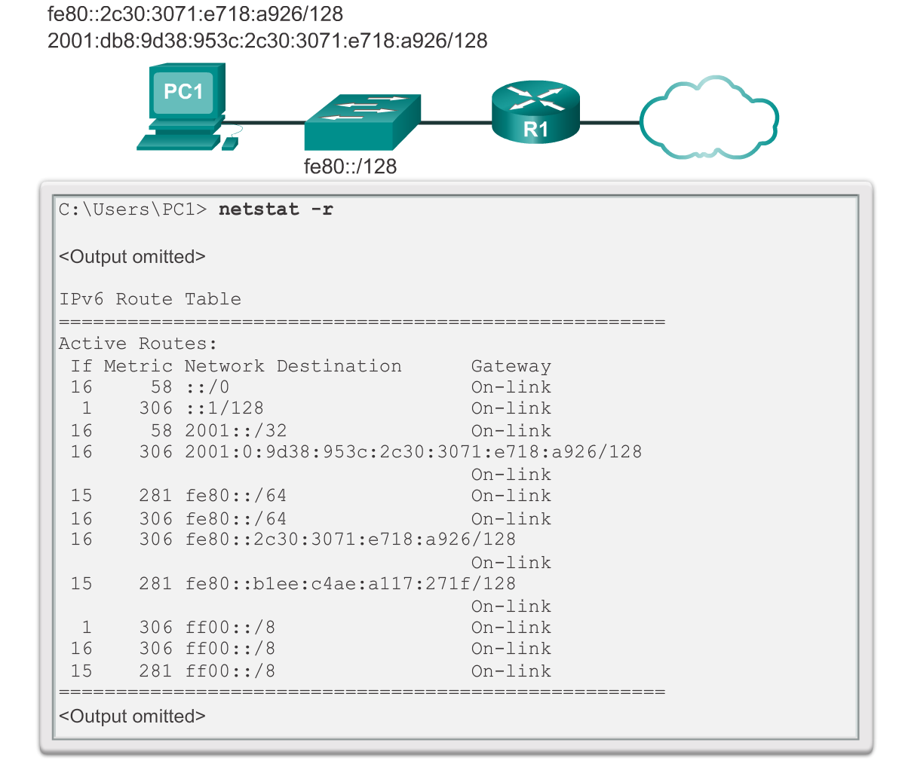
Host Tabel Routing
Sample IPv6 Host Routing Table
PRAKTIKUM
Notes:
Section 6.2.1.6

Slide 27
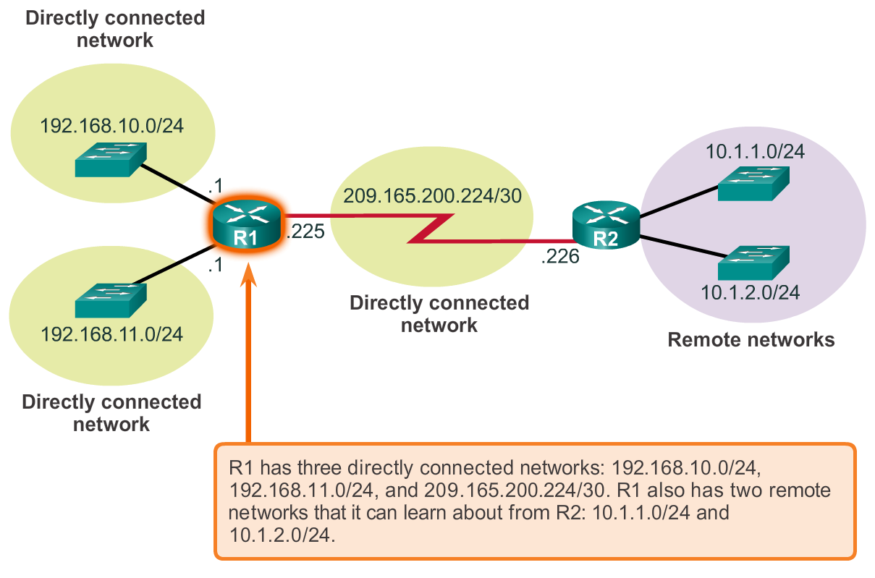
Tabel Routing Router
Router Packet Forwarding Decision
Notes:
Section 6.2.2.1

Slide 28
Tabel Routing Router
IPv4 Router Routing Table
PRAKTIKUM
192.168.10.0/24
10.1.1.0/24
PC1
.10
G0/0
.1
209.165.200.224 /30
.10
.1
R1
.225
S0/0/0
.226
R2
.10
.1
G0/1
.1
.10
PC2
192.168.11.0/24
10.1.2.0/24
R1#show ip route
Codes: L - local, C - connected, S - static, R - RIP, M - mobile, B - BGP
D - EIGRP, EX - EIGRP external, O - OSPF, IA - OSPF inter area
N1 - OSPF NSSA external type 1, N2 - OSPF NSSA external type 2
E1 - OSPF external type 1, E2 - OSPF external type 2, E - EGP
i - IS-IS, L1 - IS-IS level-1, L2 - IS-IS level-2, ia - IS-IS inter area
* - candidate default, U - per-user static route, o - ODR
P - periodic downloaded static route
Gateway of last resort is not set
10.0.0.0/8 is variably subnetted, 2 subnets, 2 masks
D 10.1.1.0/24 [90/2170112] via 209.165.200.226, 00:00:05, Serial0/0/0
D 10.1.2.0/24 [90/2170112] via 209.165.200.226, 00:00:05, Serial0/0/0
192.168.10.0/24 is variably subnetted, 2 subnets, 3 masks
C 192.168.10.0/24 is directly connected, GigabitEthernet0/0
L 192.168.10.1/32 is directly connected, GigabitEthernet0/0
192.168.11.0/24 is variably subnetted, 2 subnets, 3 masks
C 192.168.11.0/24 is directly connected, GigabitEthernet0/1
L 192.168.11.1/32 is directly connected, GigabitEthernet0/1
209.165.200.0/24 is variably subnetted, 2 subnets, 3 masks
C 209.165.200.224/30 is directly connected, Serial0/0/0
L 209.165.200.225/32 is directly connected, Serial0/0/0
R1#
Notes:
Section 6.2.2.2

Slide 29
Tabel Routing Router
Directly Connected Routing Table Entries
192.168.10.0/24
64.100.0.1
10.1.1.0/24
PC1
.10
G0/0
.1
209.165.200.224 /30
.10
.1
R1
.225
S0/0/0
.226
R2
.10
.1
G0/1
.1
.10
PC2
192.168.11.0/24
10.1.2.0/24
A
B
C
C 192.168.10.0/24 is directly connected, GigabitEthernet0/0
L 192.168.10.1/32 is directly connected, GigabitEthernet0/0
A | Identifies how the network was learned by the router.
B | Identifies the destination network and how it is connected.
C | Identifies the interface on the router connected to the destination network.
Notes:
Section 6.2.2.3

Slide 30
Tabel Routing Router
Remote Network Routing Table Entries
192.168.10.0/24
64.100.0.1
10.1.1.0/24
PC1
.10
G0/0
.1
209.165.200.224 /30
.10
.1
R1
.225
S0/0/0
.226
R2
.10
.1
G0/1
.1
.10
PC2
192.168.11.0/24
10.1.2.0/24
D 10.1.1.0/24 [90/2170112] via 209.165.200.226, 00:00:05, Serial0/0/0
A | Identifies how the network was learned by the router.
B | Identifies the destination network.
C | Identifies the administrative distance (trustworthiness) of the route source.
D | Identifies the metric to reach the remote network.
E | Identifies the next hop IP address to reach the remote network.
F | Identifies the amount of elapsed time since the network was discovered.
G | Identifies the outgoing interface on the router to reach the destination network.
Notes:
Section 6.2.2.4

Slide 31
Tabel Routing Router
Next-Hop Address
192.168.10.0/24
64.100.0.1
10.1.1.0/24
PC1
.10
G0/0
.1
209.165.200.224 /30
.10
.1
R1
.225
S0/0/0
.226
R2
.10
.1
G0/1
.1
.10
PC2
192.168.11.0/24
10.1.2.0/24
R1#show ip route
Codes: L - local, C - connected, S - static, R - RIP, M - mobile, B - BGP
D - EIGRP, EX - EIGRP external, O - OSPF, IA - OSPF inter area
N1 - OSPF NSSA external type 1, N2 - OSPF NSSA external type 2
E1 - OSPF external type 1, E2 - OSPF external type 2, E - EGP
i - IS-IS, L1 - IS-IS level-1, L2 - IS-IS level-2, ia - IS-IS inter area
* - candidate default, U - per-user static route, o - ODR
P - periodic downloaded static route
Gateway of last resort is not set
10.0.0.0/8 is variably subnetted, 2 subnets, 2 masks
D 10.1.1.0/24 [90/2170112] via 209.165.200.226, 00:00:05, Serial0/0/0
D 10.1.2.0/24 [90/2170112] via 209.165.200.226, 00:00:05, Serial0/0/0
192.168.10.0/24 is variably subnetted, 2 subnets, 3 masks
C 192.168.10.0/24 is directly connected, GigabitEthernet0/0
L 192.168.10.1/32 is directly connected, GigabitEthernet0/0
192.168.11.0/24 is variably subnetted, 2 subnets, 3 masks
C 192.168.11.0/24 is directly connected, GigabitEthernet0/1
L 192.168.11.1/32 is directly connected, GigabitEthernet0/1
209.165.200.0/24 is variably subnetted, 2 subnets, 3 masks
C 209.165.200.224/30 is directly connected, Serial0/0/0
L 209.165.200.225/32 is directly connected, Serial0/0/0
R1#
Notes:
Section 6.2.2.5

Slide 32
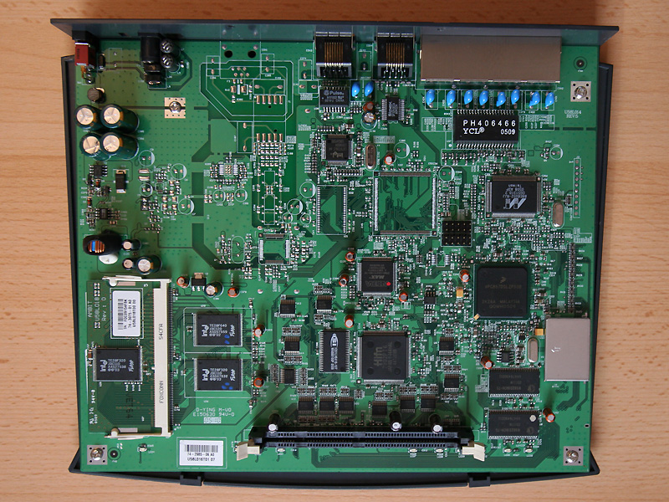
Router
Anatomi Router
Notes:
Section 6.3.1

Slide 33
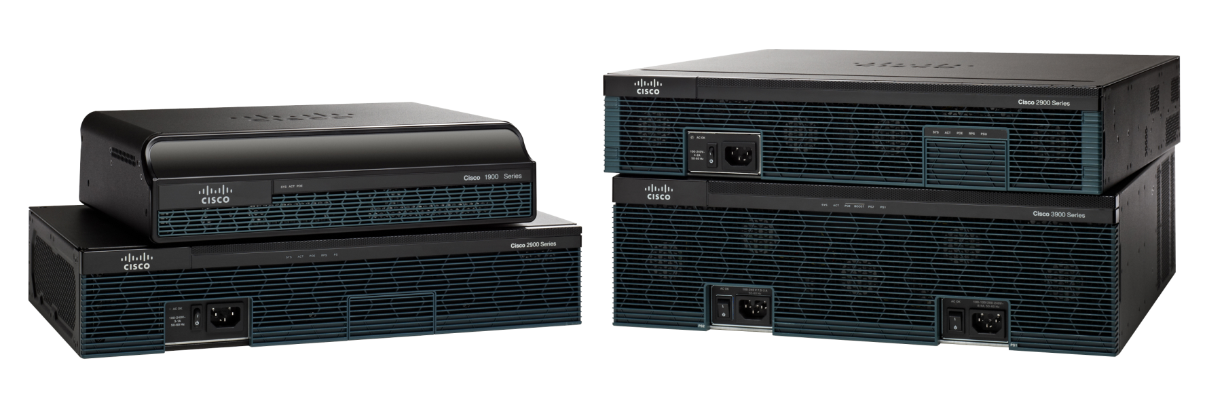
Router
Router Adalah Komputer
Notes:
Section 6.3.1.1

Slide 34
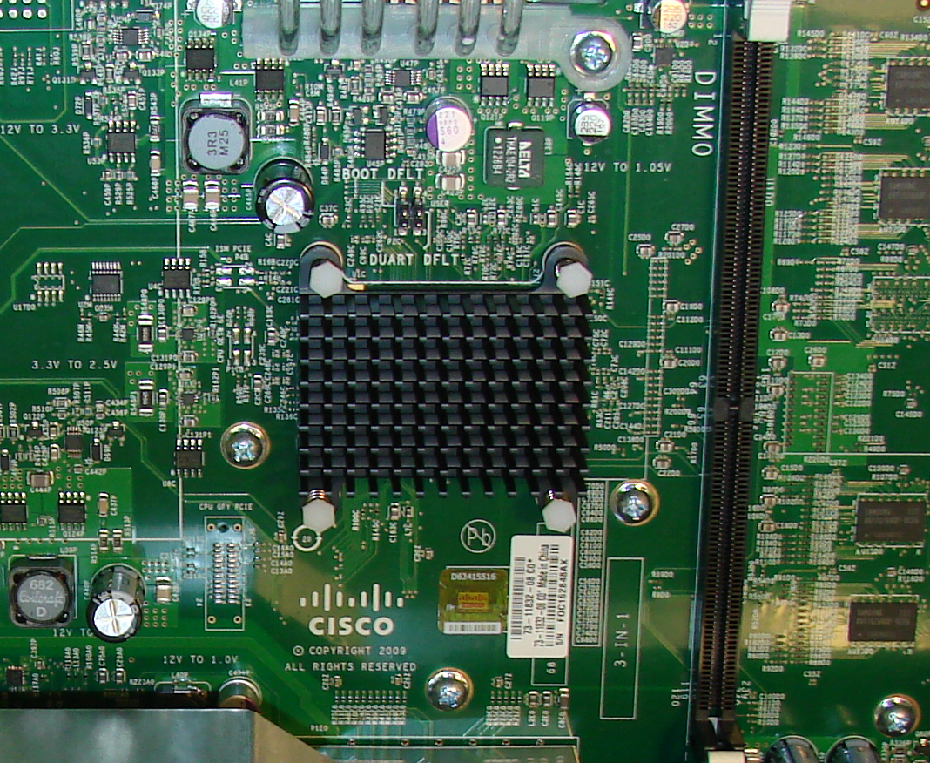
Anatomi Router
CPU dan OS Router
Notes:
Section 6.3.1.2

Slide 35
Anatomi Router
Memori Router
Memory | Volatile / Non-Volatile | Stores
RAM | Volatile | Running IOS Running configuration file IP routing and ARP tables Packet buffer
ROM | Non-Volatile | Bootup instructions Basic diagnostic software Limited IOS
NVRAM | Non-Volatile | Startup configuration file
Flash | Non-Volatile | IOS Other system files
Notes:
Section 6.3.1.3

Slide 36
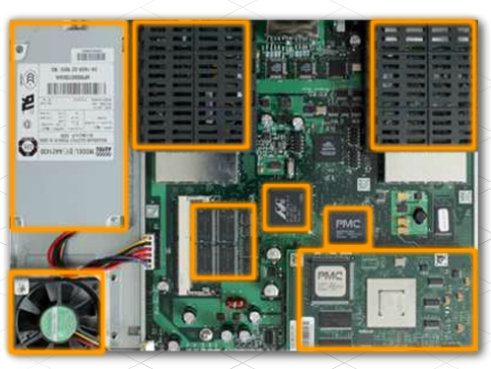
Anatomi Router
Di dalam Sebuah Router
Notes:
Section 6.3.1.4

Slide 37
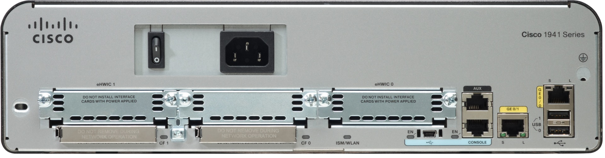
Anatomi Router
Bagian Belakang Router
Double-wide eHWIC slots
eHWIC 0
AUX
port
LAN
interfaces
Console RJ45
USB
Ports
Two 4 GB flash card slots
Console
USB Type B
Notes:
Section 6.3.1.5

Slide 38
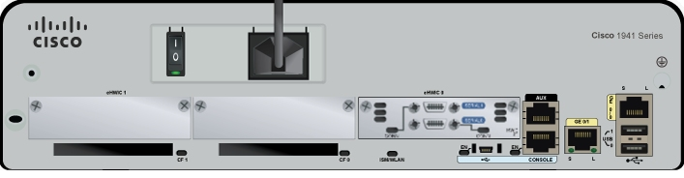
Anatomi Router
Terhubung ke Router
WAN
Interface
AUX
port
LAN
interfaces
Console RJ45
Console
USB Type B
Notes:
Section 6.3.1.6

Slide 39
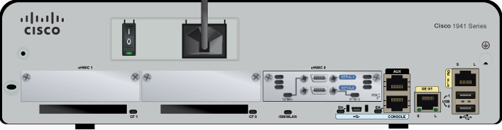
Anatomi Router
Antarmuka LAN dan WAN
Serial interfaces
LAN interfaces
Notes:
Section 6.3.1.7

Slide 40
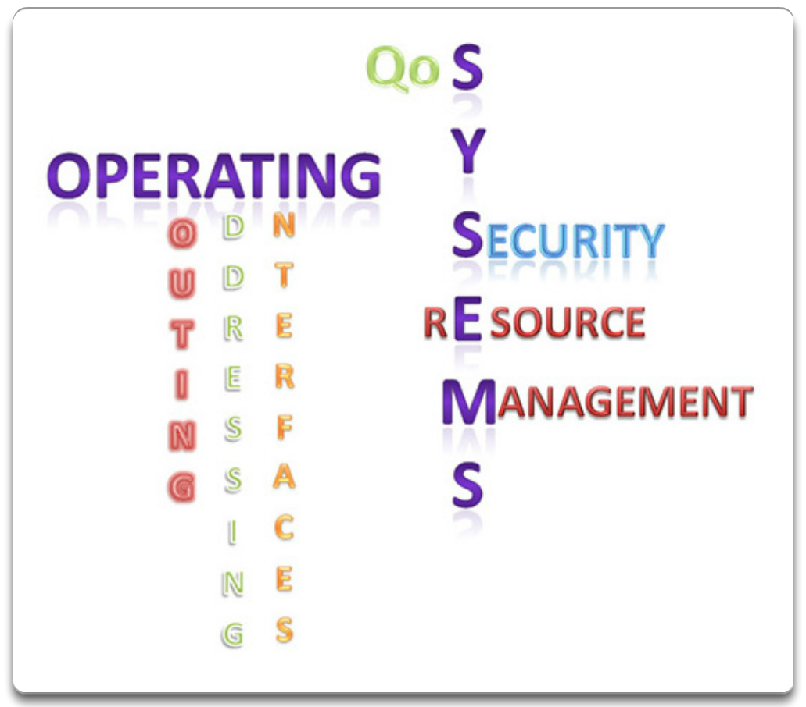
Boot-up Router
Cisco IOS
Notes:
Section 6.3.2.1

Slide 41
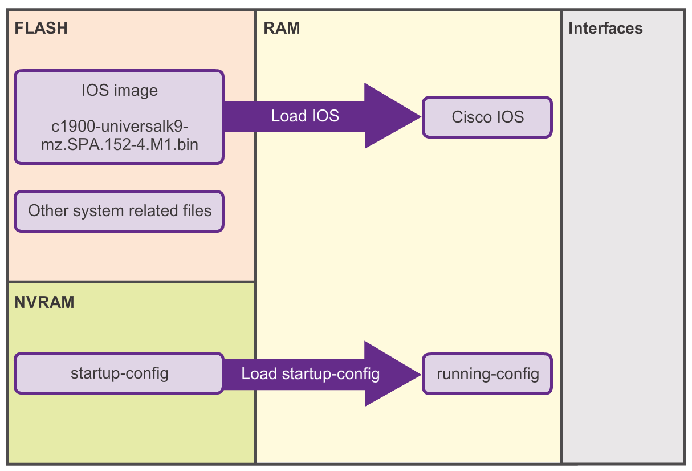
Boot-up Router
File - file Bootset
Notes:
Section 6.3.2.2

Slide 42
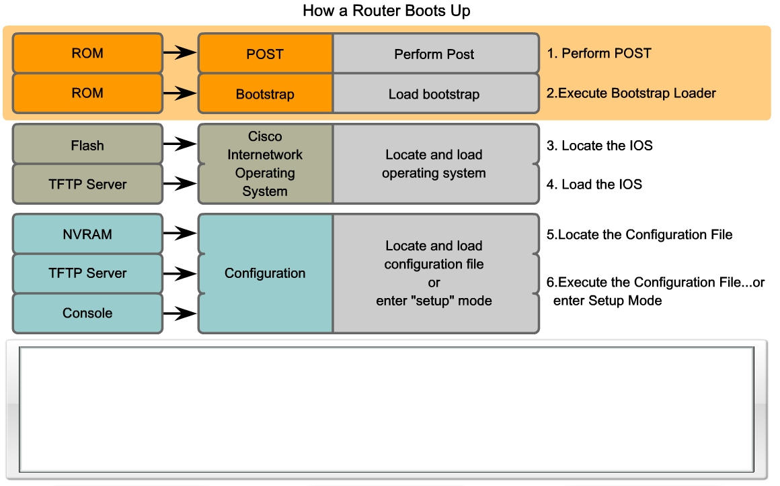
Boot-up Router
Router Bootup Process
Melakukan POST dan load program bootstrap
Mencari dan me-load software Cisco IOS
Mencari dan me-load File startup configuration atau masuk mode setup
System Bootstrap, Version 15.0(1r)M15, RELEASE SOFTWARE (fc1)
Technical Support: http://www.cisco.com/techsupport
<output omitted>
Notes:
Section 6.3.2.3

Slide 43
Boot-up Router
Show Versions Output
PRAKTIKUM
Router# show version
Cisco IOS Software, C1900 Software (C1900-UNIVERSALK9-M), Version 15.2(4)M1, RELEASE SOFTWARE (fc1)
Technical Support: http://www.cisco.com/techsupport
Copyright (c) 1986-2012 by Cisco Systems, Inc.
Compiled Thu 26-Jul-12 19:34 by prod_rel_team
ROM: System Bootstrap, Version 15.0(1r)M15, RELEASE SOFTWARE (fc1)
Router uptime is 10 hours, 9 minutes
System returned to ROM by power-on
System image file is "flash0:c1900-universalk9-mz.SPA.152-4.M1.bin"
Last reload type: Normal Reload
Last reload reason: power-on
<Output omitted>
Cisco CISCO1941/K9 (revision 1.0) with 446464K/77824K bytes of memory.
Processor board ID FTX1636848Z
2 Gigabit Ethernet interfaces
2 Serial(sync/async) interfaces
1 terminal line
DRAM configuration is 64 bits wide with parity disabled.
255K bytes of non-volatile configuration memory.
250880K bytes of ATA System CompactFlash 0 (Read/Write)
<Output omitted>
Technology Package License Information for Module:'c1900'
-----------------------------------------------------------------
Technology Technology-package Technology-package
Current Type Next reboot
------------------------------------------------------------------
ipbase ipbasek9 Permanent ipbasek9
security None None None
data None None None
Configuration register is 0x2142 (will be 0x2102 at next reload)
Router#
Notes:
Section 6.3.2.4

Slide 44
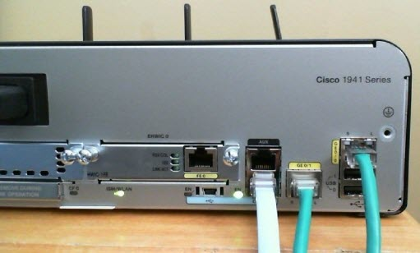
Layer Network
Mengkonfigurasi Router Cisco
Notes:
Section 6.4

Slide 45
Configure Settingan Awal
Langkah – Langkah Mengkonfigurasi Router
PRAKTIKUM
192.168.10.0/24
10.1.1.0/24
PC1
.10
G0/0
.1
209.165.200.224 /30
.10
.1
R1
.225
S0/0/0
.226
R2
.10
.1
G0/1
.1
.10
PC2
192.168.11.0/24
10.1.2.0/24
Router> enable
Router# configure terminal
Enter configuration commands, one per line. End with CNTL/Z.
Router(config)# hostname R1
R1(config)#
Router> en
Router# conf t
Enter configuration commands, one per line. End with CNTL/Z.
Router(config)# ho R1
R2(config)#
OR
R1(config)# enable secret class
R1(config)#
R1(config)# line console 0
R1(config-line)# password cisco
R1(config-line)# login
R1(config-line)# exit
R1(config)#
R1(config)# line vty 0 4
R1(config-line)# password cisco
R1(config-line)# login
R1(config-line)# exit
R1(config)#
R1(config)# service password-encryption
R1(config)#
R1(config)# banner motd #
Enter TEXT message. End with the character '#'.
***********************************************
WARNING: Unauthorized access is prohibited!
***********************************************
#
R1(config)#
R1# copy running-config startup-config
Destination filename [startup-config]?
Building configuration...
[OK]
R1#
Notes:
Section 6.4.1.1

Slide 46
Mengkonfigurasi Antarmuka
Mengkonfigurasi Antarmuka LAN
PRAKTIKUM
192.168.10.0/24
10.1.1.0/24
PC1
.10
G0/0
.1
209.165.200.224 /30
.10
.1
R1
.225
S0/0/0
.226
R2
.10
.1
G0/1
.1
.10
PC2
192.168.11.0/24
10.1.2.0/24
R1# conf t
Enter configuration commands, one per line. End with CNTL/Z.
R1(config)#
R1(config)# interface gigabitethernet 0/0
R1(config-if)# ip address 192.168.10.1 255.255.255.0
R1(config-if)# description Link to LAN-10
R1(config-if)# no shutdown
%LINK-5-CHANGED: Interface GigabitEthernet0/0, changed state to up
%LINEPROTO-5-UPDOWN: Line protocol on Interface GigabitEthernet0/0, changed state to up
R1(config-if)# exit
R1(config)#
R1(config)# int g0/1
R1(config-if)# ip add 192.168.11.1 255.255.255.0
R1(config-if)# des Link to LAN-11
R1(config-if)# no shut
%LINK-5-CHANGED: Interface GigabitEthernet0/1, changed state to up
%LINEPROTO-5-UPDOWN: Line protocol on Interface GigabitEthernet0/1, changed state to up
R1(config-if)# exit
R1(config)#
Notes:
Section 6.4.2.1

Slide 47
Mengkonfigurasi Antarmuka
Verifikasi Konfigurasi Antarmuka
PRAKTIKUM
192.168.10.0/24
10.1.1.0/24
PC1
.10
G0/0
.1
209.165.200.224 /30
.10
.1
R1
.225
S0/0/0
.226
R2
.10
.1
G0/1
.1
.10
PC2
192.168.11.0/24
10.1.2.0/24
R1# show ip interface brief
Interface IP-Address OK? Method Status Protocol
GigabitEthernet0/0 192.168.10.1 YES manual up up
GigabitEthernet0/1 192.168.11.1 YES manual up up
Serial0/0/0 209.165.200.225 YES manual up up
Serial0/0/1 unassigned YES NVRAM administratively down down
Vlan1 unassigned YES NVRAM administratively down down
R1#
R1# ping 209.165.200.226
Type escape sequence to abort.
Sending 5, 100-byte ICMP Echos to 209.165.200.226, timeout is 2 seconds:
!!!!!
Success rate is 100 percent (5/5), round-trip min/avg/max = 1/2/9 ms
R1#
Notes:
Section 6.4.2.2

Slide 48
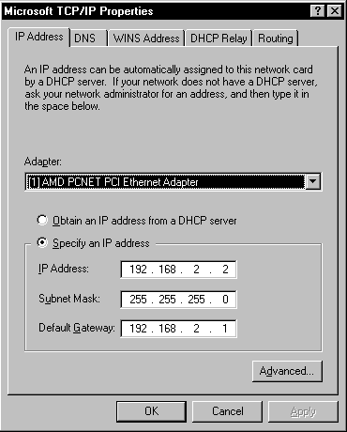
Mengkonfigurasi Router Cisco
Mengkonfigurasi Default Gateway
PRAKTIKUM
Notes:
Section 6.4.3

Slide 49
Mengkonfigurasi Default Gateway
Default Gateway pada Host
PC1
.10
192.168.10.0/24
.1
G0/0
PC2
.10
R1
G0/1
.1
PC1
.10
PC3
.10
192.168.10.0/24
.1
G0/0
.10
192.168.11.0/24
PC2
.11
PC4
R1
G0/1
.1
PC3
.10
.11
192.168.11.0/24
PC4
Notes:
Section 6.4.3.1

Slide 50

Mengkonfigurasi Default Gateway
Default Gateway pada Switch
S1#show running-config
Building configuration...
!
<output omitted>
service password-encryption
!
hostname S1
!
Interface Vlan1
ip address 192.168.10.50
!
ip default-gateway 192.168.10.1
<output omitted>
PC1
.10
192.168.11.0/24
192.168.10.0/24
.1
G0/0
.1
G0/1
.11
S1
R1
S2
PC2
.50
If the default gateway were not configured on S1, response packets from S1 would not be able to reach the administrator at 192.168.11.10. The administrator would not be able to mange the device remotely.
Notes:
Section 6.4.3.2

Slide 51
Layer Network
Simpulan
Pada Chapter ini, Anda belajar:
Layer network, atau OSI Layer 3, menyediakan layanan agar devais ujung dapat bertukar data melalui jaringan.
Layer network menggunakan empat proses dasar : IP addressing untuk devais ujung, enkapsulasi, peroutingan, dan de-enkapsulasi.
Sebagian besar Internet berbasis IPv4, yang masih digunakan luas sebagai protokol layer network.
Paket IPv4 mengandung header IP dan payload.
Header IPv6 yang telah disederhanakan menawarkan beberapa keunggulan dibanding IPv4, mencakup efisiensi routing yang lebih baik, ekstensi header yang tersederhanakan, dan kapabilitas untuk pemrosesan per-flow
Notes:
Section 1.5 & 1.5.1

Slide 52
Layer Network
Simpulan
Pada chapter ini, Anda belajar:
Sebagai tambahan pada pengalamatan hirarkikal, layer network juga bertanggungjawab untuk perutingan.
Host membutuhkan tabel routing lokal untuk memastikan paket telah diarahkan ke jaringan tujuan yang tepat.
Route default lokal adalah route menuju default gateway.
Default gateway adalah IP address dari antarmuka router yang terhubung ke jaringan lokal.
Ketika router, seperti default gateway, menerima packet, akan melihat IP address tujuan untuk menentukan jaringan tujuan.
Notes:
Section 1.5 & 1.5.1

Slide 53
Layer Network
Simpulan
Pada chapter ini, kamu belajar:
Tabel routing dari sebuah router menyimpan informasi tentang rute directly-connected dan route remote dari jaringan IP. Jika router memiliki sebuah entri dalam routing tabelnya untuk jaringan tujuan, router akan mem-forward paket. Jika tidak ada entri, router akan mem-forward paket ke router default route jika sudah terkonfigurasi, jika tidak maka paket akan didrop.
Entri dari tabel Routing dapat dikonfigurasi secara manual pada tiap router untuk menyediakan routing static atau router dapat bertukar data router dengan sesama router secara dinamis menggunakan protokol routing.
Agar router dapat dijangkau, antarmuka haruslah dikonfigurasi terlebih dahulu.
Notes:
Section 1.5 & 1.5.1

Slide 54


